Slide 1


Gym Membership
System Database
Database that models how a gym manages members, memberships, and check-in activity.
Grace Okoro
Amrita Penke

Slide 2
Introduction
This project is a gym membership database inspired by Planet Fitness. The goal was to model how a gym stores member information, membership plans, and check-in activity in a database system.
The system tracks five main things: gym locations, members, membership plans, membership records, and check-in events. Everything is connected through foreign keys so the data stays organized and consistent.

Slide 3
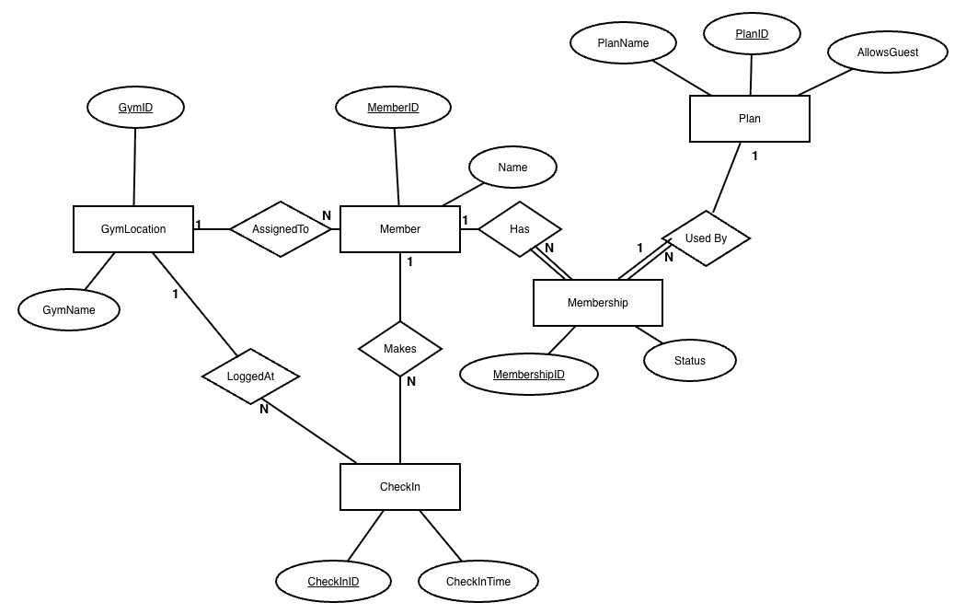
ER Diagram
There are five main tables: GymLocation, Member, Plan, Membership, and CheckIn.
The Member table is basically the center of the system because members connect to their home gym, their membership record, and their check-in activity.
All of the relationships are one-to-many. For example, one gym location can have many members, and one member can have many check-ins.

Slide 4
Relationships
This chart explains how the tables are connected through foreign keys. All of the main relationships in this database are one-to-many.
#
Relationship
Cardinality
Foreign Key
Purpose
1
GymLocation to Member
1:N
GymLocation
One gym can be home to many members
2
Member to Membership
1:N
Member
One member can have many membership records
3
Plan to Membership
1:N
Plan
One plan can be used by many memberships
4
Member to CheckIn
1:N
Member
One member can make many check-ins
5
GymLocation to CheckIn
1:N
GymLocation
One gym can have many check-ins

Slide 5
Relational Schema – Part 1
Tables that store basic information for the system
CREATE TABLE GymLocation(
GymID NUMBER(5) PRIMARY KEY,
GymName VARCHAR2(50) NOT NULL
);
CREATE TABLE Member (
MemberID NUMBER(5) PRIMARY KEY,
Name VARCHAR2(50) NOT NULL,
HomeGymID NUMBER(5),
CONSTRAINT member_homegym_fk
FOREIGN KEY (HomeGymID)
REFERENCES GymLocation(GymID)
);
CREATE TABLE Plan(
PlanID NUMBER(3) PRIMARY KEY,
PlanName VARCHAR2(30) NOT NULL UNIQUE,
AllowsGuest CHAR(1) DEFAULT 'N',
CONSTRAINT plan_guest_ck
CHECK (AllowsGuest IN ('Y','N'))
);
GymLocation
Member
Plan
Stores the two gym locations.
GymID (PK) to identify each gym.
Stores each member.
MemberID (PK)
HomeGymID (FK) to connect each member to home gym
Stores membership plan types
Basic = No Guests
Black = Guests Allowed
Constraint values = Y or N
ActiveMembers View
CREATE OR REPLACE VIEW ActiveMembers AS
SELECT m.MemberID, m.Name, p.PlanName, ms.Status
FROM Member m
JOIN Membership ms ON m.MemberID = ms.MemberID
JOIN Plan p ON ms.PlanID = p.PlanID
WHERE ms.Status = 'ACTIVE';
The view joins Member, Membership, and Plan to only show members with an active status.

Slide 6
Relational Schema – Part 2
Tables that store membership status and check-in activity
CREATE TABLE Membership (
MembershipID NUMBER(5) PRIMARY KEY,
MemberID NUMBER(5) NOT NULL,
PlanID NUMBER(3) NOT NULL,
Status VARCHAR2(10) DEFAULT 'ACTIVE',
CONSTRAINT membership_member_fk
FOREIGN KEY (MemberID)
REFERENCES Member(MemberID),
CONSTRAINT membership_plan_fk
FOREIGN KEY (PlanID)
REFERENCES Plan(PlanID),
CONSTRAINT membership_status_ck
CHECK (Status IN
('ACTIVE','EXPIRED','CANCELLED'))
);
CREATE TABLE CheckIn(
CheckInID NUMBER(8) PRIMARY KEY,
MemberID NUMBER(5) NOT NULL,
GymID NUMBER(5) NOT NULL,
CheckInTime TIMESTAMP
DEFAULT SYSTIMESTAMP,
CONSTRAINT checkin_member_fk
FOREIGN KEY (MemberID)
REFERENCES Member(MemberID),
CONSTRAINT checkin_gym_fk
FOREIGN KEY (GymID)
REFERENCES GymLocation(GymID)
);
CREATE OR REPLACE TRIGGER
trg_active_checkin
BEFORE INSERT ON CheckIn
FOR EACH ROW
DECLARE
v_count NUMBER;
BEGIN
SELECT COUNT(*) INTO v_count
FROM Membership
WHERE MemberID = :NEW.MemberID
AND Status = 'ACTIVE';
IF v_count = 0 THEN
RAISE_APPLICATION_ERROR(
-20001,
'Member does not have an
active membership');
END IF;
END;
/
100+ Rows
- 102 rows in Member
- 102 rows in Membership
- 112+ rows in CheckIn
Notes:
This slide shows the second part of my relational schema. These tables handle the actual membership status and gym activity.
The Membership table connects a member to a plan. It stores the MemberID, the PlanID, and the member’s status. The status can only be ACTIVE, EXPIRED, or CANCELLED because I added a check constraint. This keeps the data consistent.
The CheckIn table records when a member enters the gym. Each check-in has a CheckInID, a MemberID, a GymID, and a timestamp. The MemberID connects the check-in to the member, and the GymID connects it to the gym location.
The trigger is the main business rule on this slide. Before a check-in is inserted, the trigger checks the Membership table to see if the member has an active membership. If the member is expired or cancelled, the trigger blocks the check-in.
I also used loops to meet the data requirement. The database has 102 members, 102 memberships, and 112 check-ins, so it meets the 100 plus row requirement.

Slide 7
SQL Query 1: The Most Active Member
SELECT m.Name,
COUNT(c.CheckInID) AS TotalWorkouts
FROM Member m
JOIN CheckIn c
ON m.MemberID = c.MemberID
GROUP BY m.Name
ORDER BY TotalWorkouts DESC
FETCH FIRST 1 ROWS ONLY;
NAME TOTALWORKOUTS
---------------- -------------
Bob Smith 1001 55
1 row selected.
This query joins Member and CheckIn using MemberID, counts each member’s check-ins, groups the totals by member, and returns the person with the highest number of visits.

Slide 8
SQL Query 2: Most Crowded Location
SELECT g.GymName,
COUNT(c.CheckInID) AS FootTraffic
FROM GymLocation g
LEFT JOIN CheckIn c
ON g.GymID = c.GymID
GROUP BY g.GymName
ORDER BY FootTraffic DESC
FETCH FIRST 1 ROWS ONLY;
GYMNAME FOOTTRAFFIC
------------------------ -----------
Planet Fitness Downtown 68
1 row selected.
This query joins GymLocation to CheckIn using GymID, counts the check-ins for each gym, groups the totals by location, and returns the gym with the highest foot traffic.

Slide 9
SQL Query 3: Guest Privileges
Find active members whose plan allows guest access — 3-table JOIN
SELECT m.Name, p.PlanName
FROM Member m
JOIN Membership ms
ON m.MemberID = ms.MemberID
JOIN Plan p
ON ms.PlanID = p.PlanID
WHERE p.AllowsGuest = 'Y'
AND ms.Status = 'ACTIVE'
FETCH FIRST 10 ROWS ONLY;
NAME PLANNAME
-------------------- ----------
Robert Johnson 3 Black Card
Michael Brown 5 Black Card
William Miller 7 Black Card
David Garcia 9 Black Card
Daniel Martin 15 Black Card
Anthony White 17 Black Card
...
10 rows selected.
This query joins Member, Membership, and Plan to find active members whose plan allows guests. The filters require AllowsGuest = 'Y' and Status = 'ACTIVE', so expired members and Basic plan members are excluded.

Slide 10
SQL Query 4: Expired Members + Trigger Test
Find expired members then demonstrate the trigger blocking a check-in
SELECT m.Name,
MAX(c.CheckInTime) AS LastVisit
FROM Member m
JOIN Membership ms
ON m.MemberID = ms.MemberID
LEFT JOIN CheckIn c
ON m.MemberID = c.MemberID
WHERE ms.Status = 'EXPIRED'
GROUP BY m.Name
ORDER BY LastVisit DESC
FETCH FIRST 5 ROWS ONLY;
NAME LASTVISIT
----------------- -------------------
Carol Davis (null)
Linda Williams 4 29-APR-26 08.10 AM
Barbara Jones 6 29-APR-26 06.10 AM
...
5 rows selected.
-- Carol (1002) has EXPIRED membership
INSERT INTO CheckIn
VALUES (999, 1002, 2, SYSTIMESTAMP);
⛔ TRIGGER OUTPUT
ERROR at line 1:
ORA-20001: Member does not
have an active membership
ORA-06512: at
"TRG_ACTIVE_CHECKIN",
line 9
ORA-04088: error during
execution of trigger
This query finds members with an EXPIRED membership status and uses a LEFT JOIN to keep them in the result even if they don’t have any check-ins. MAX(CheckInTime) shows the most recent visit for each expired member. We confirmed the trigger works by inserting a check-in for Carol Davis, whose membership is expired. Therefore, Oracle blocked our attempt.

Slide 11
GUI Abilities
Python + tkinter interface connected to Oracle — gym_gui.py
Members View
Add Check-in
Shows all 102 members from the Member table with their home gym and membership status.
INSERT into CheckIn — the trigger fires here. Expired members get blocked with ORA-20001.
View Plans
Update Status
Displays both plans (Basic and Black Card) with their AllowsGuest value.
UPDATE Membership SET Status — change a member to EXPIRED, then try checking them in to show the trigger.
Check-in Log
Delete Member
Lists all check-ins from the CheckIn table with timestamps and gym location.
Deletes CheckIn → Membership → Member in order, respecting FK constraints.
Add Member
INSERT into Member and Membership — creates both rows so the member is immediately active.

Slide 12



Technologies Used
Tools and languages used to build this project
tk
DATABASE
BACKEND
FRONTEND
Oracle DB
Python
tkinter
Oracle SQL stored tables, check constraints and foreign keyto run and manage database.
GUI code written in Python. Connected to Oracle, runs SQL statements, and manages all actions.
Created the windows, tables, buttons, and popup forms.

Slide 13
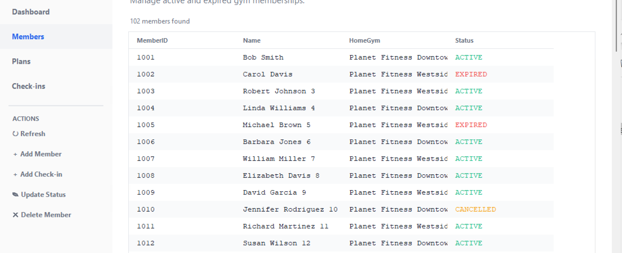
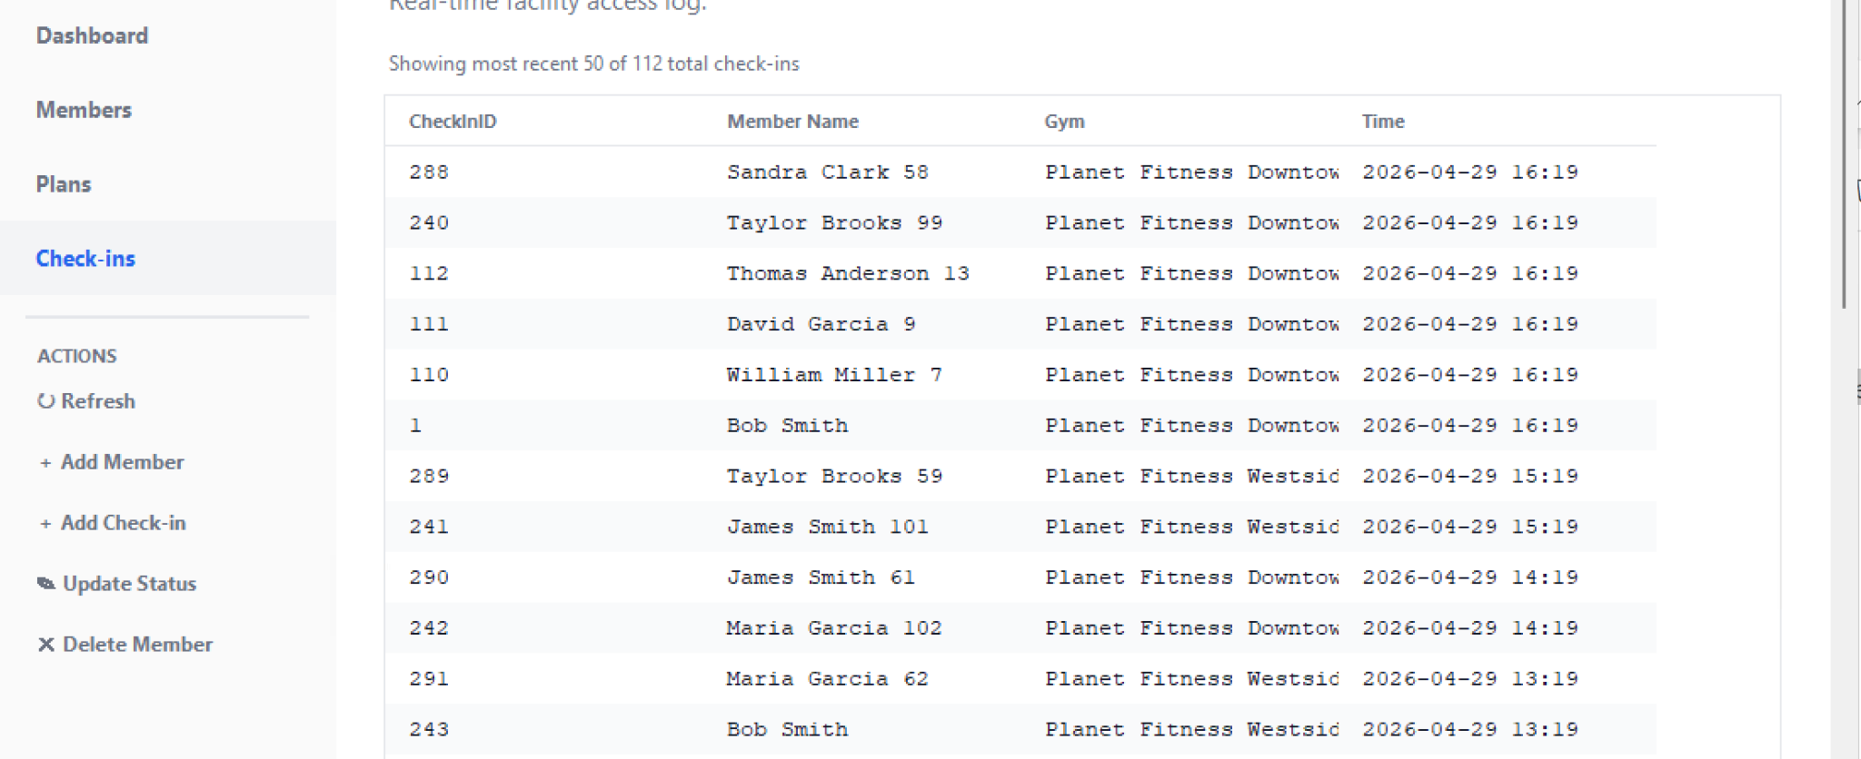
UI Dashboard & Database Integration

Slide 14
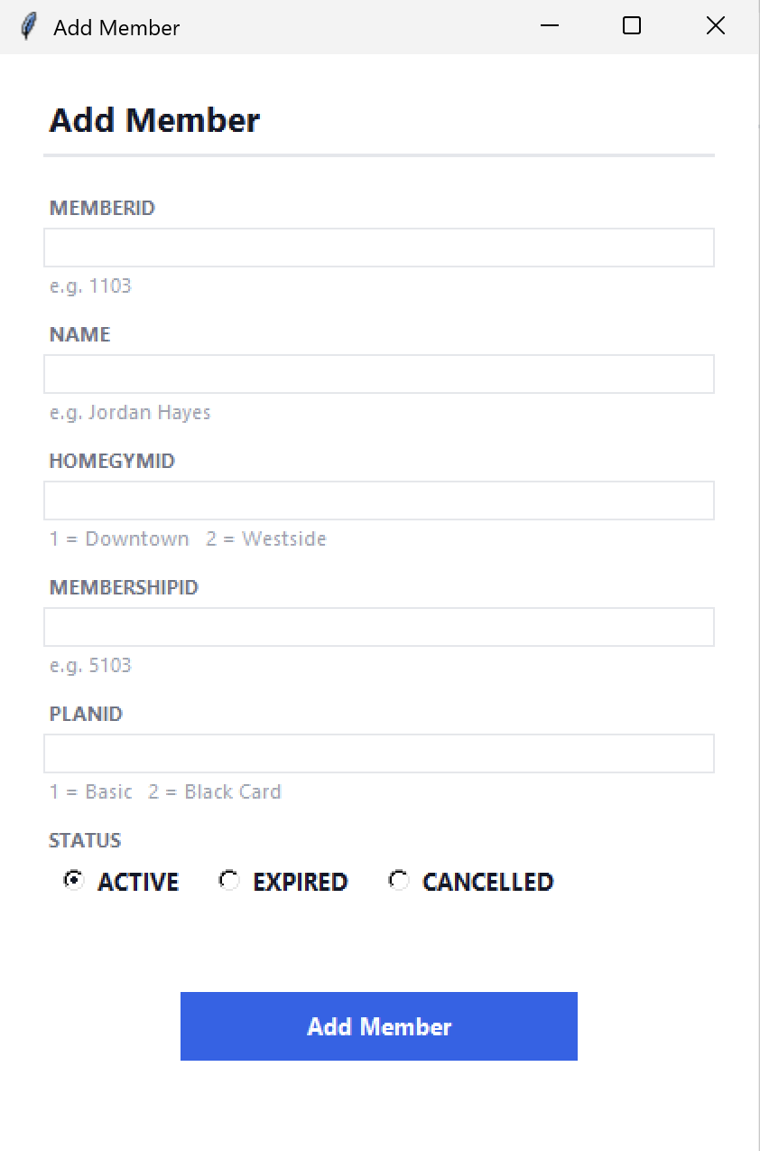
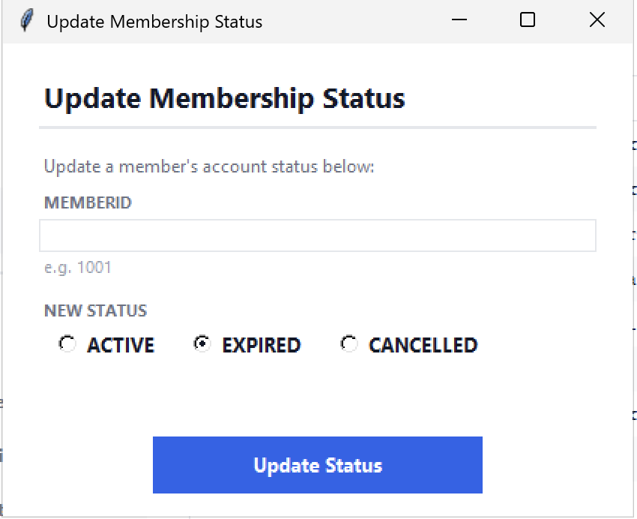
UI Dashboard & Database Integration

Slide 15
Future Work
Future Work
Add date-based expiry
Automatically set Status = EXPIRED when EndDate passes, using a scheduled trigger or date columns.
Staff and trainer tables
Add staff roles, personal trainers, and class scheduling as separate entities.
Guest check-in table
Track guest visits separately and tie them to the Black Card member who sponsored them.

